Slide 1


To listen for specific information: how John and Mary describe the TV shows or movies.
To learn to talk about one’s favorite TV shows and explain reasons.
To learn some new words about different types of movies.

Slide 2


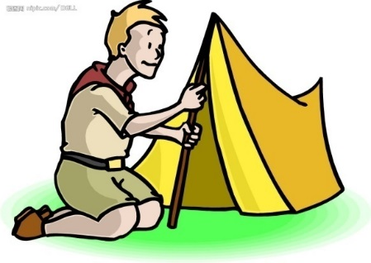
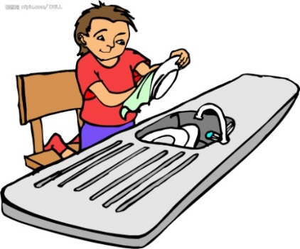

看图, 根据所给的单词和短语完成句子。
Mike, plan, camp in the forest, next weekend
Mike plans to camp in the forest next weekend.
Jack, want, help mom do the dishes, this evening
Jack wants to help mom do the dishes this evening.
Bob, start, skate, when he was five
Bob started to skate when he was five.

Slide 3
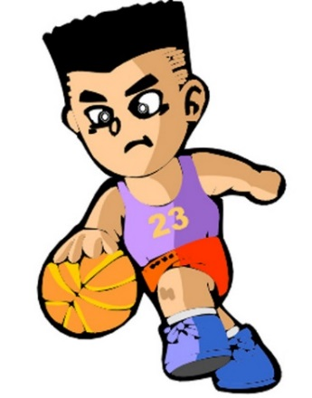
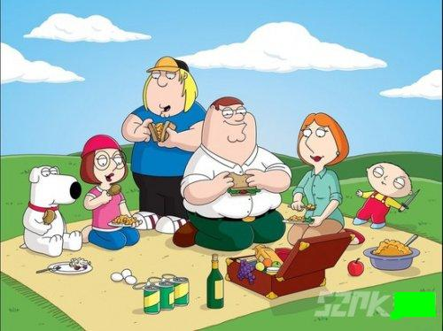
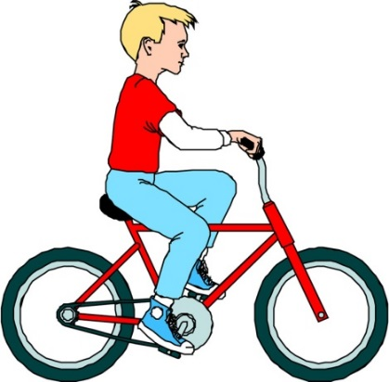
Jack, hope, play basketball, after class
Jack hopes to play basketball after class.
my sister, expect, have a picnic, next weekend
My sister expects to have a picnic next weekend.
Eric, decide, ride his bike to school, tomorrow
Eric decides to ride his bike to school tomorrow.

Slide 4



What do you think of game shows? Why?
I like them. Because they’re interesting.
I don’t like them. Because they’re boring.

Slide 5

What do you think of news? Why?
I can’t stand them. Because they’re too serious.
I don’t mind them. They’re educational.

Slide 6


What kind of movie is it? What do you think of it?
I think cartoons are enjoyable. I love action movies, but I can’t stand scary movies.
我认为动画片很有意思。我喜欢动作电影，但我不能忍受恐怖电影。
I think … is / are…
I love / can’t stand / don’t mind…

Slide 7


What do you think of these TV shows and movies?
I think comedies are relaxing. I love scary movies, but I can’t stand action movies.
I think … is / are…
I love / can’t stand / don’t mind…
I like watching… because…
I never watch…because…

Slide 8


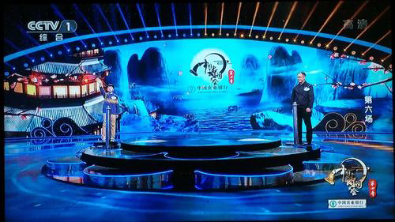
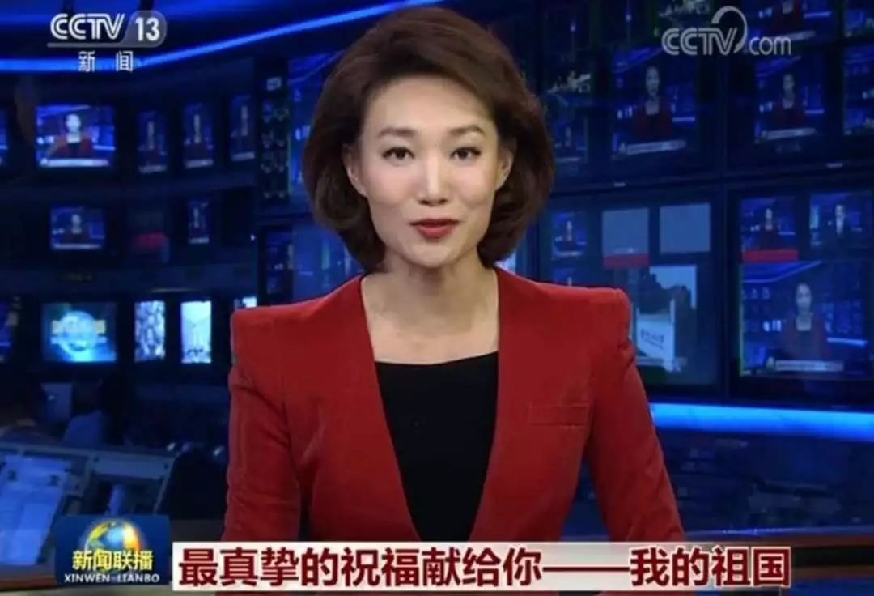
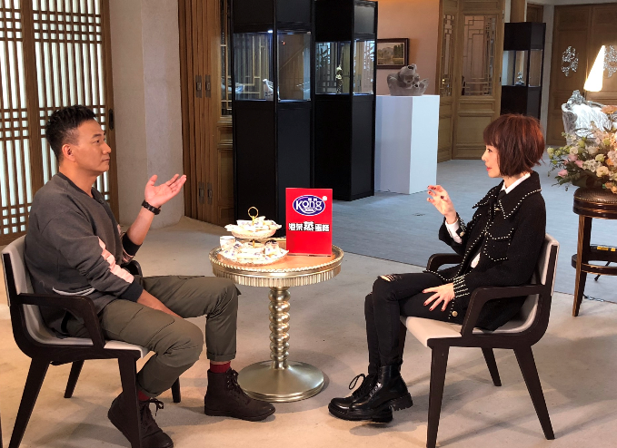

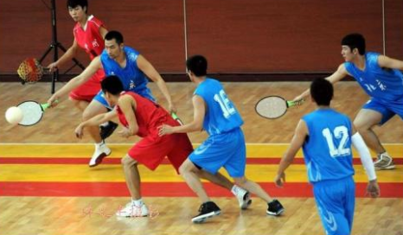
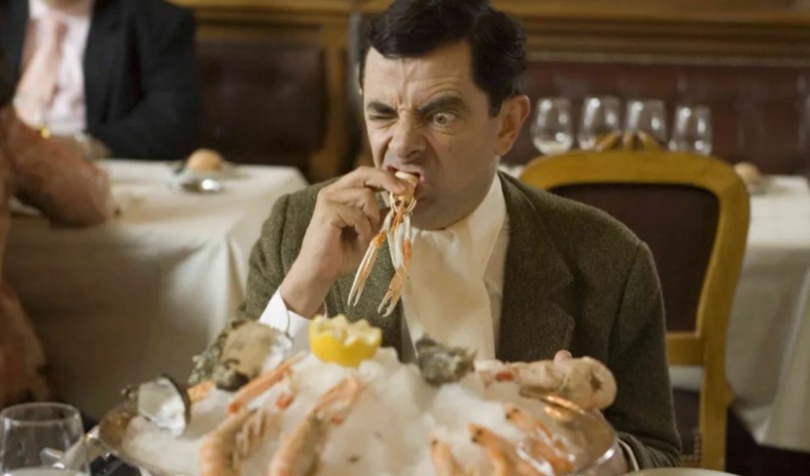
Review
What kinds of TV shows did we learn?
Try to describe(描述) them.
soap opera sitcom game show news
talk show talent show sports show comedy

Slide 9

Unit 5

Slide 10



Slide 11
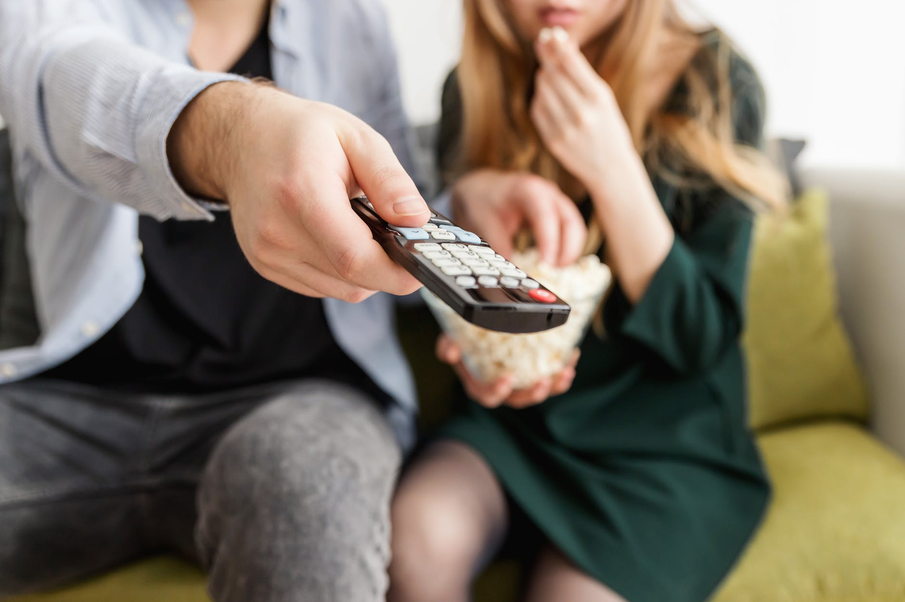
Unit 5
Do you want to watch a game show?

Slide 12
Activity:Complete the sentences.
1. 你期望从情景喜剧中学到什么？
What can you ______ ______ ______ from sitcoms?
2. 你能学到一些很好的笑话。
You can ______ some great ______.
3. 你为什么喜欢看新闻呢？
Why do you like _______ _______ _______?
4. 因为我希望了解世界各地正在发生什么事情。
Because I _______ _______ _______ _______ what’s going on around the world.
expect to learn
learn jokes
watching the news
hope to find out

Slide 13
5. 你想看新闻吗？
Do you want to ______ ______ ______?
6. 是的，我想看。/ 不，我不想看。
Yes, I do. / No, I don’t.
7. 你计划今晚看什么节目？
______ do you ______ ______ watch tonight?
8. 我计划看《我们过去的时代》。
I ______ ______ watch Days of Our Past.
watch the news
What
plan to
plan to

Slide 14
9. 你觉得访谈节目怎么样？
What do you think of ______ ______?
10. 我不介意看。/ 我不能忍受。/ 我爱看。
I don’t _______ them. / I ______ _______ them! / I _______ ________ them!
talk shows
mind
can’t stand
love watching

Slide 15
Review
What kinds of TV shows did we learn?
soap opera sitcom game show news
talk show talent show sports show comedy

Slide 16


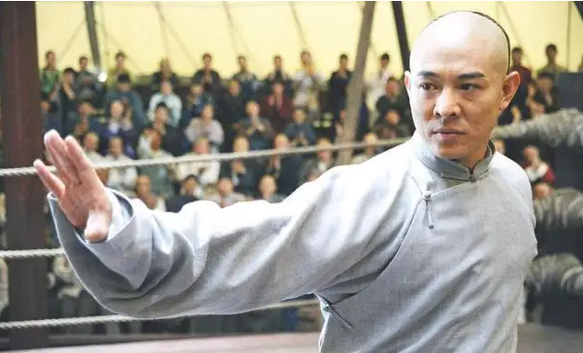
Presentation
What kinds of movies are they?
zombie
cartoon
动画片
action movie
动作电影
scary movie
恐怖电影

Slide 17

What do you think of these TV shows and movies? Choose words from the box and write them under the pictures. Each picture can have more than one word.

Slide 18
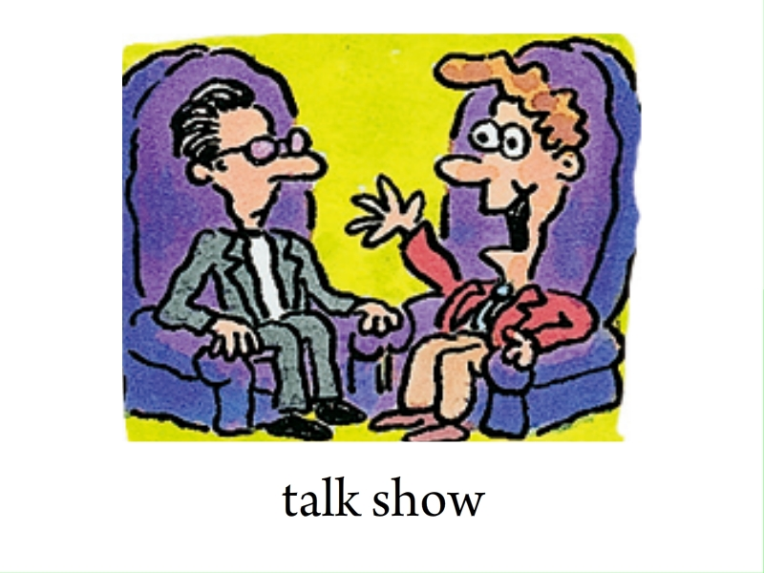
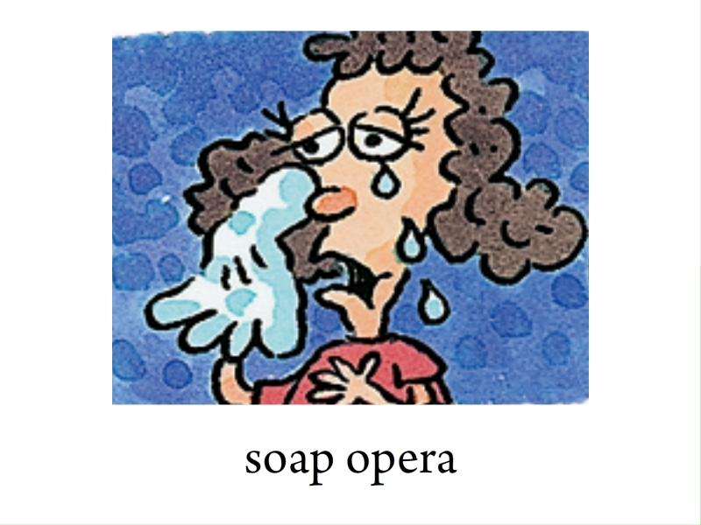
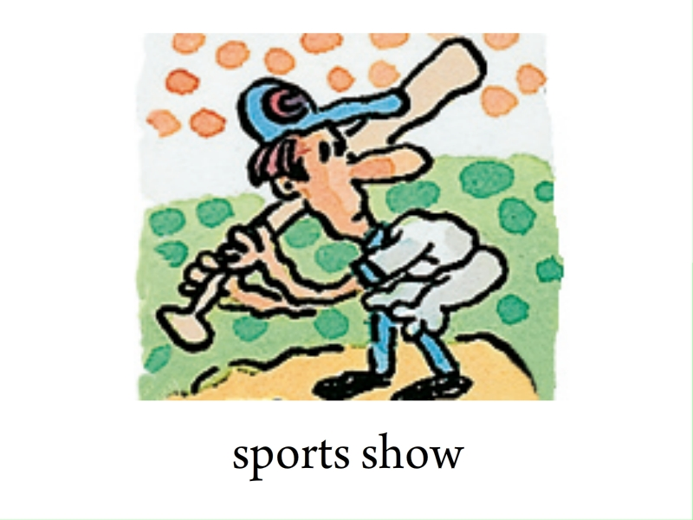
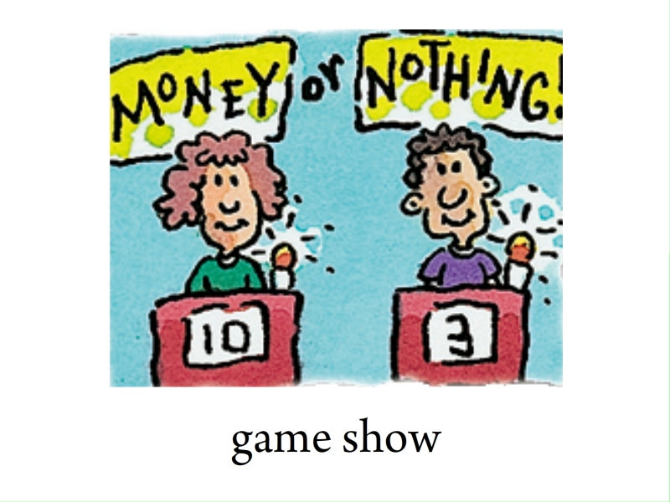

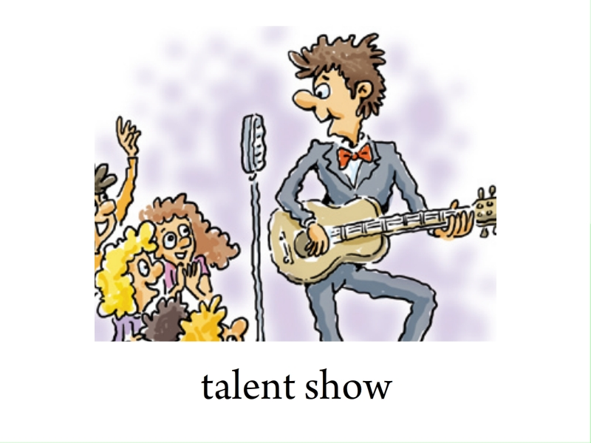
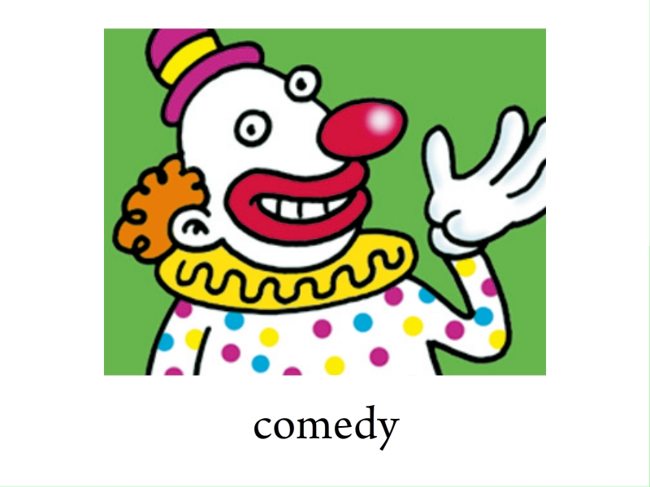
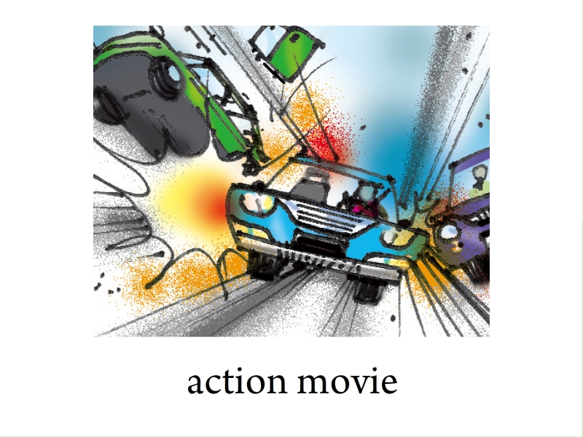
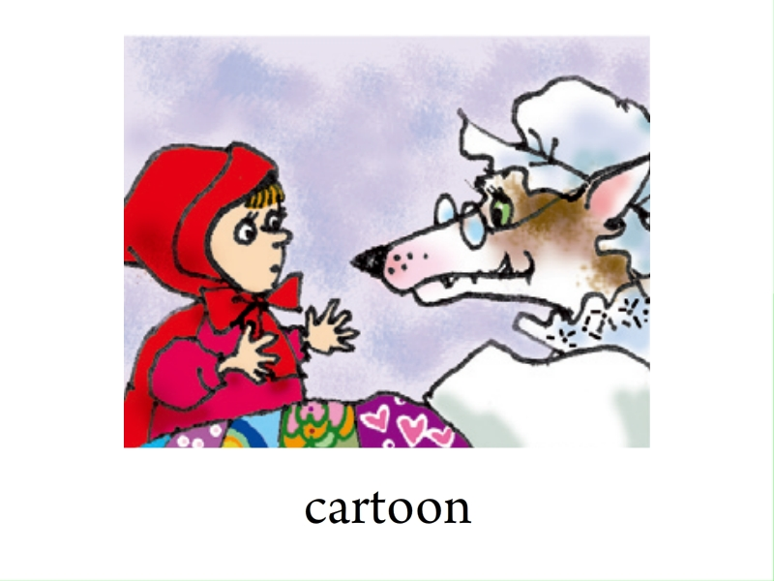
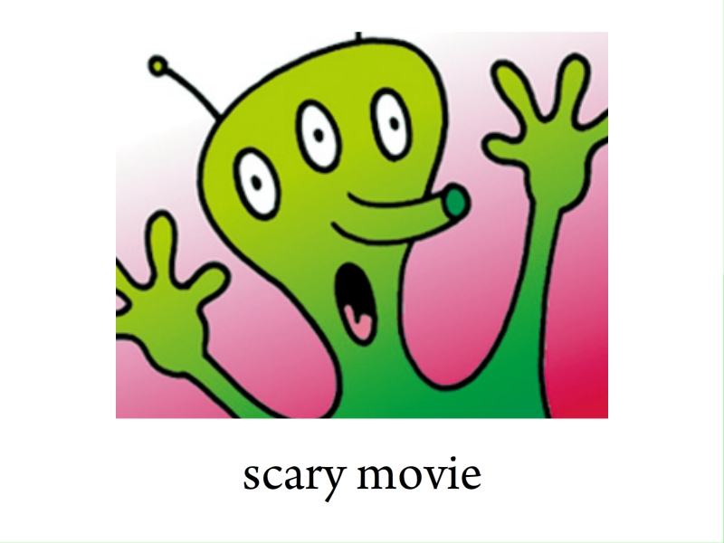
educational serious wonderful relaxing
meaningless enjoyable exciting boring

Slide 19
educational serious wonderful relaxing meaningless enjoyable exciting boring
relaxing
exciting
educational
serious
meaningless
enjoyable
wonderful
relaxing
wonderful exciting
enjoyable relaxing
exciting

Slide 20




Listen and circle the description words you hear in the box in 1a.
educational serious wonderful relaxing
meaningless enjoyable exciting boring

Slide 21

Listen again. Write down the words John and Mary use to describe the TV shows or movies.
 | Action movies | Scary movies | Game shows | Sitcoms | Talk shows
John | exciting
Mary
exciting
boring
boring
enjoyable
meaningless
meaningless
relaxing
relaxing
wonderful

Slide 22
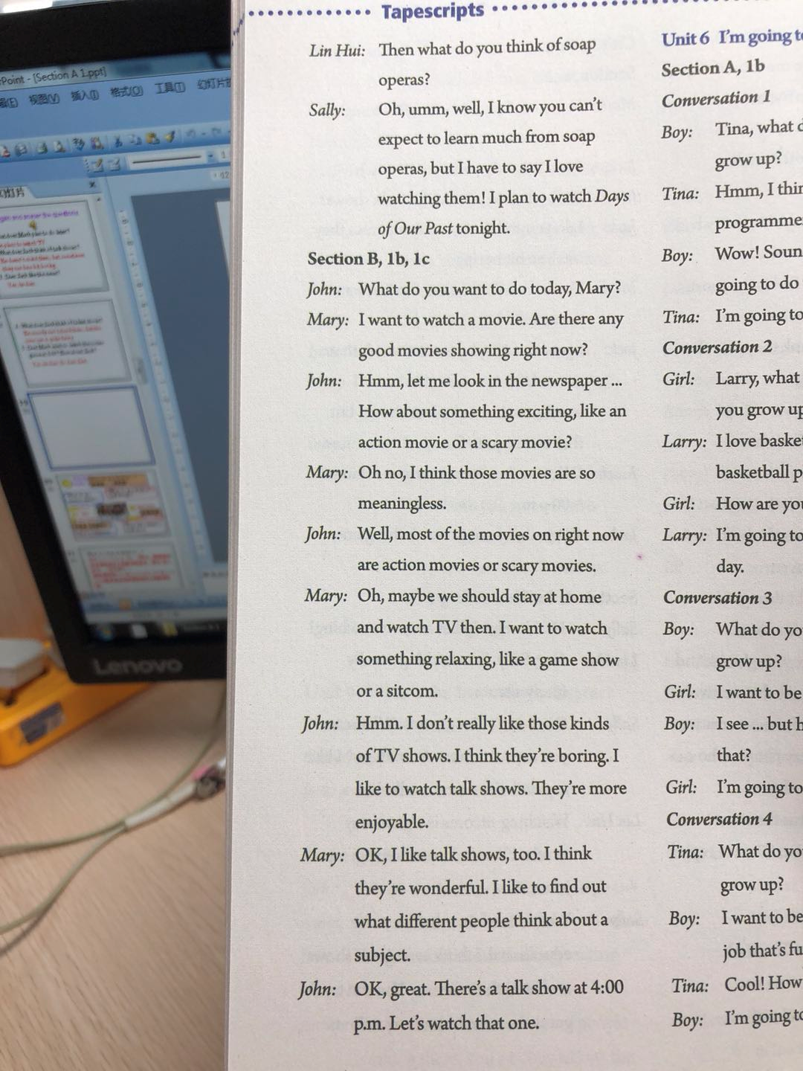

Slide 23

Activity
Make a conversation and then practice it with a partner.
A: What do you plan to watch on TV tonight?
B: I hope to _________________, but I also want to _________________. How about you? Do you _________________ a talk show or _______________?
A: Oh, I want to _________________.
watch game shows
watch sports shows
want to watch
a soap opera
watch a soap opera

Slide 24

Answer these questions. Give answers that are true for you.
1. What do you think of game shows?
_______________________________________________
2. What comedy shows do you like to watch?
_______________________________________________
3. Do you plan to watch a sports show tonight?
_______________________________________________
4. What can you expect to learn from the news?
_______________________________________________
I love/like/don’t mind/can’t stand them.
I like to watch The Funnyman/Comedy Central Roast.
Yes, I do. I think it’s exciting./ No, I don’t.
I expect to find out what’s going on around the world.

Slide 25


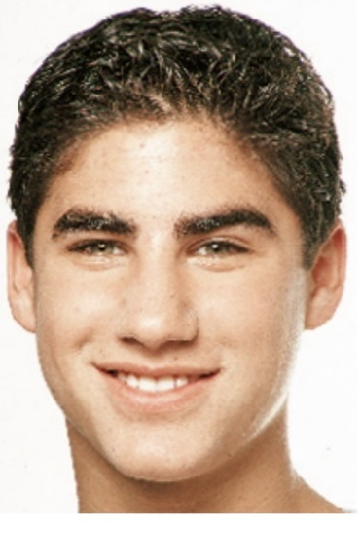
Tell your partner what John and Mary like to watch and why. Then tell your partner what you like to watch and why.
John wants to watch talk shows because they’re enjoyable. I like to watch action movies because they’re exciting.

Slide 26

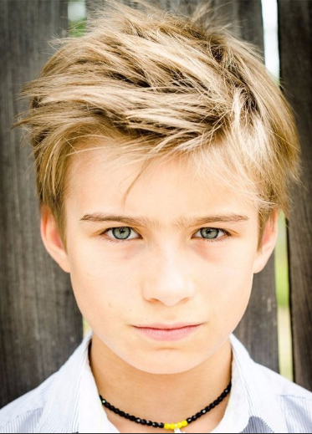
Mary wants to watch talk shows because they’re wonderful. I like to watch action movies because they’re exciting.
John wants to watch … because they’re … I like to watch … because they’re …

Slide 28
Look at the tapescripts and answer the questions.
1. What did Mary want to watch at the beginning?
2. What kind of movies does John like? Why? What does Mary think of them?
3. What kind of TV shows does Mary like? Does John like them? Why?
4. What kind of TV shows do John and Mary both like? What do Mary and John think of them?

Slide 29
1. What did Mary want to watch at the beginning?
2. What kind of movies does John like? Why? What does Mary think of them?
3. What kind of TV shows does Mary like? Does John like them? Why?
She wanted to watch a movie.
John likes action movies and scary movies. Because those movies are exciting. Mary thinks those movies are meaningless.
Mary likes game shows and sitcoms.
No, John doesn’t like them. He thinks they’re boring.

Slide 30
4. What kind of TV shows do John and Mary both like? What do Mary and John think of them?
They both like talk shows. Mary thinks they’re more enjoyable. John thinks they’re wonderful.

Slide 31


meaningless adj. 毫无意义的; 意思不明确的
名词meaning (意思) + 后缀less (无, 没有) → meaningless, 是个多音节形容词。
e.g. My dad doesn’t like soap operas. He thinks they’re meaningless. (翻译)
我爸爸不喜欢肥皂剧，他认为它们没有意义。

Slide 32

action movie 动作影片
scary movie 恐怖电影
How about something exciting…?
I think those movies are meaningless.
I want to watch something relaxing…
I think they’re boring.
I think they’re wonderful.

Slide 33

根据括号内的提示完成句子。
1. Jill doesn’t like watching _______ _______(动作影片).
2. Jane never watches scary movies. She thinks they are _____________. (meaning).
3. Linda watched two ______________(电影) last night and both of them were interesting.
action movies
meaningless
films / movies

Slide 34


Write a short passage to tell what your family like to watch and why.
Preview the passage on page 37.

Slide 35


